Slide 1
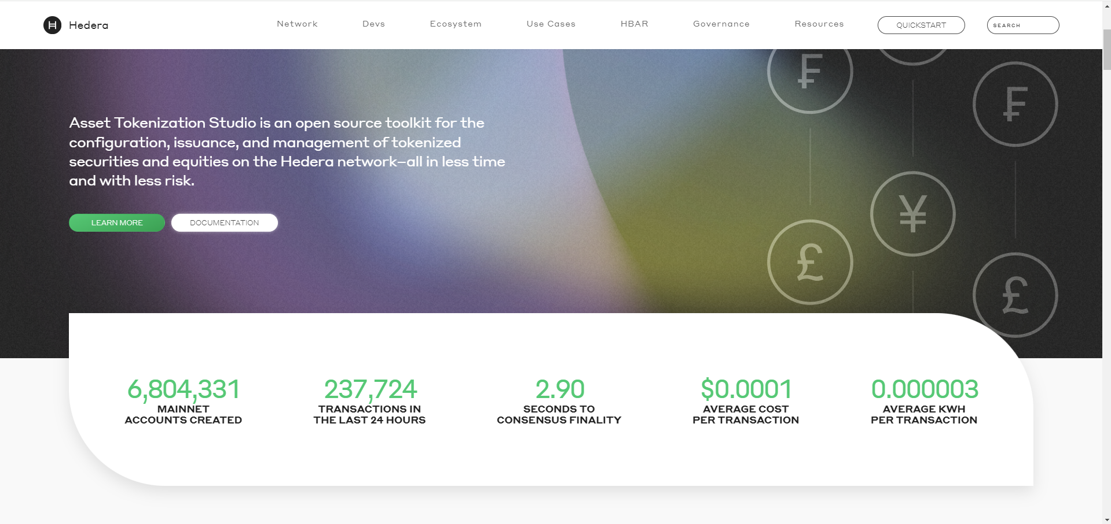
HEDERA DATA API

Slide 2
Content
Api Usage
How to collect data information
Data structure comparison
Result overview

Slide 3
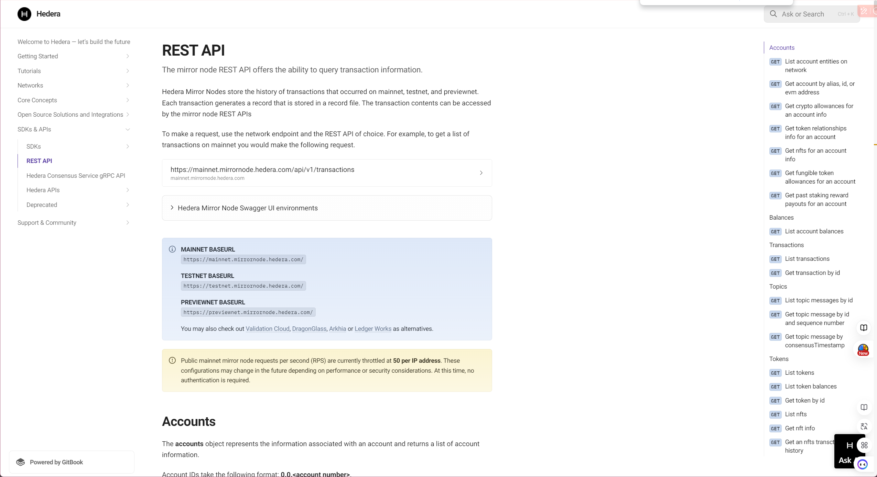
Hedera official document
Notes:
Hedera Mirror Nodes store the history of transactions that occurred on mainnet, testnet, and previewnet. Each transaction generates a record that is stored in a record file. The transaction contents can be accessed by the mirror node REST APIs. (https://docs.hedera.com/hedera/sdks-and-apis/rest-api)

Slide 4
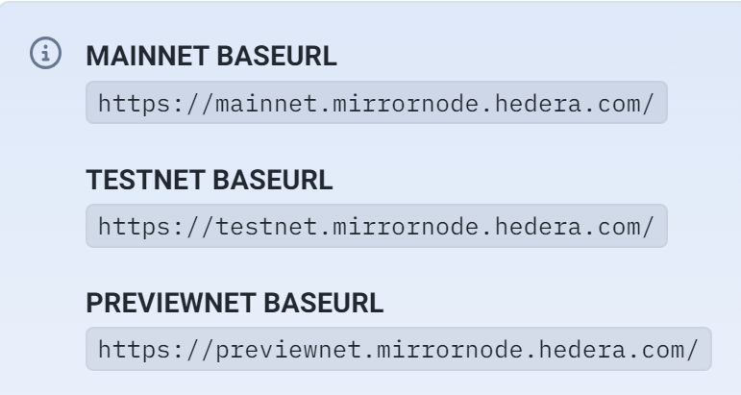
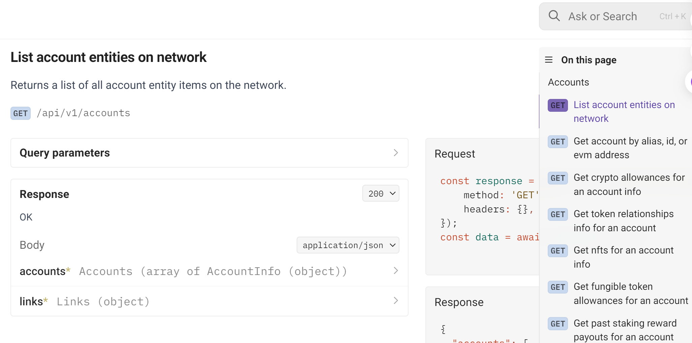
REST API USAGE
To make a request, use the network endpoint and the REST API of choice. For example, to get a list of account entity on mainnet you would make the following request
1. base url
2. Sub url
Notes:
Base_url + suburl = what you want ，find the mainnet node as the base url ,and joint the sub url want you want

Slide 5
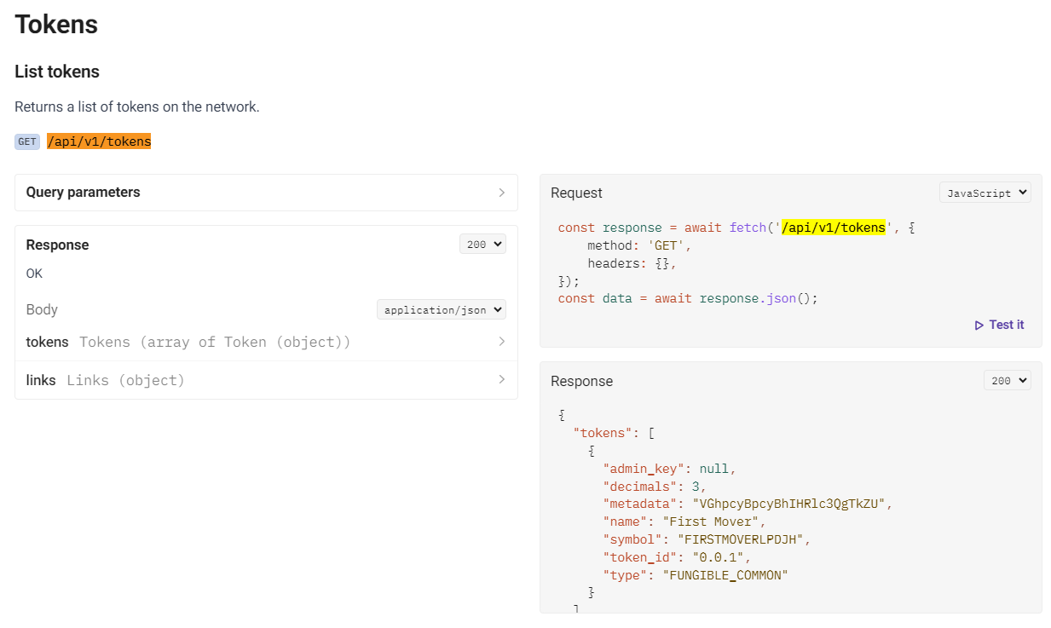
Data Acquisition Solution
/api/v1/tokens
Notes:
Get 29,011 contracts in hedera block chain, 25,811 traded

Slide 6
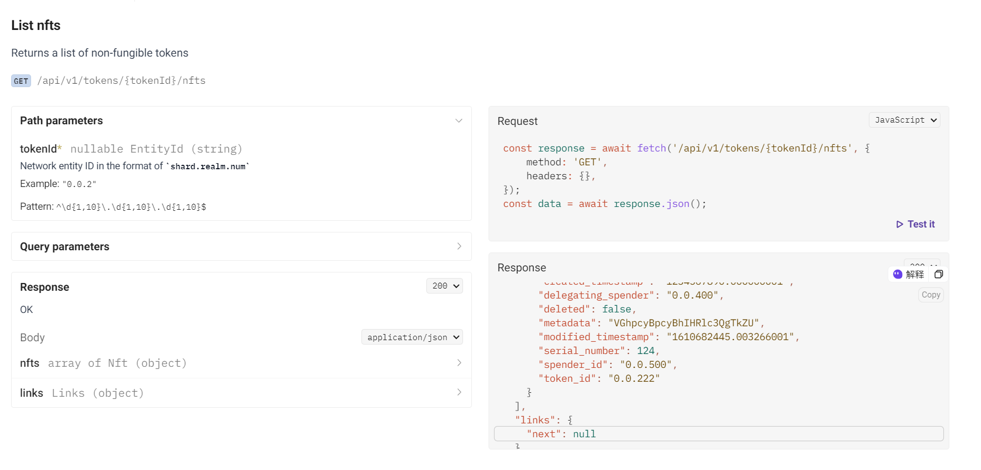
Data Acquisition Solution
/api/v1/tokens/{tokenId}/nfts
Notes:
Use token id of each contracts to get each series number of each token id, （series num 唯一编码）跟以太坊不一样，数据层面上抽象描述

Slide 7
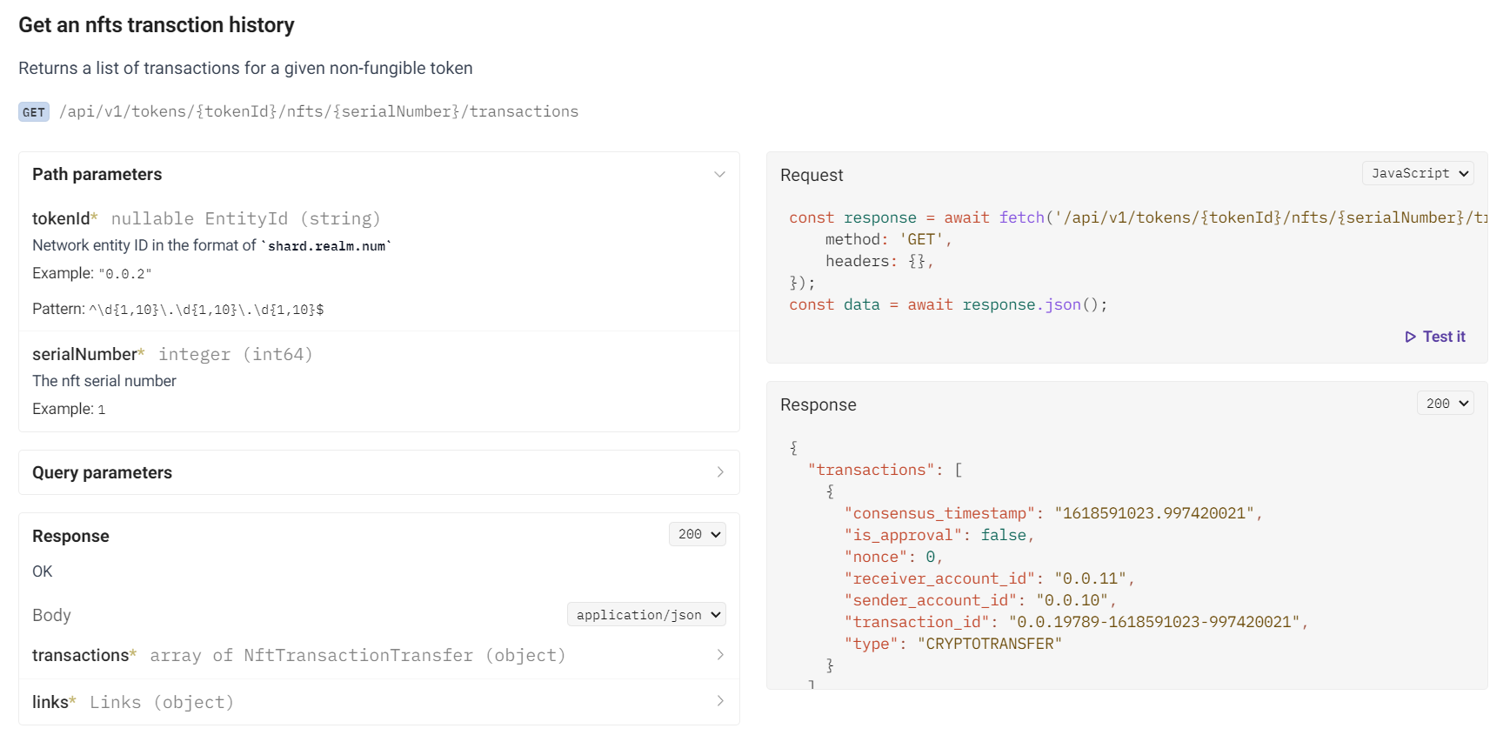
Data Acquisition Solution
/api/v1/tokens/{tokenId}/nfts/{serialNumber}/transactions
Notes:
Iterate over all the token and series number of each contract above to get the transactions (mint ,deleted , cryptos transfer,cryptos trades ) for each contract
Total 9 M + transactions records in hedera up to 2024/ 8/26

Slide 8
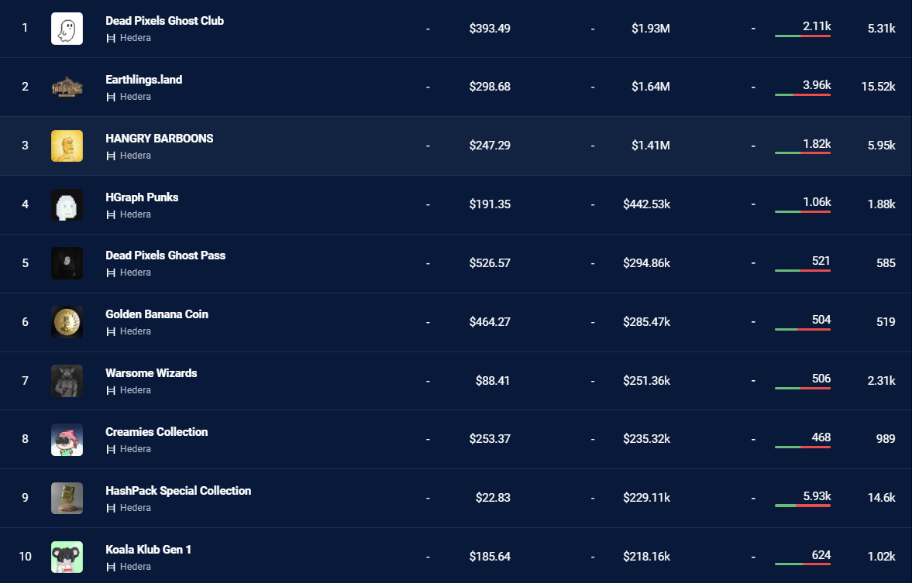
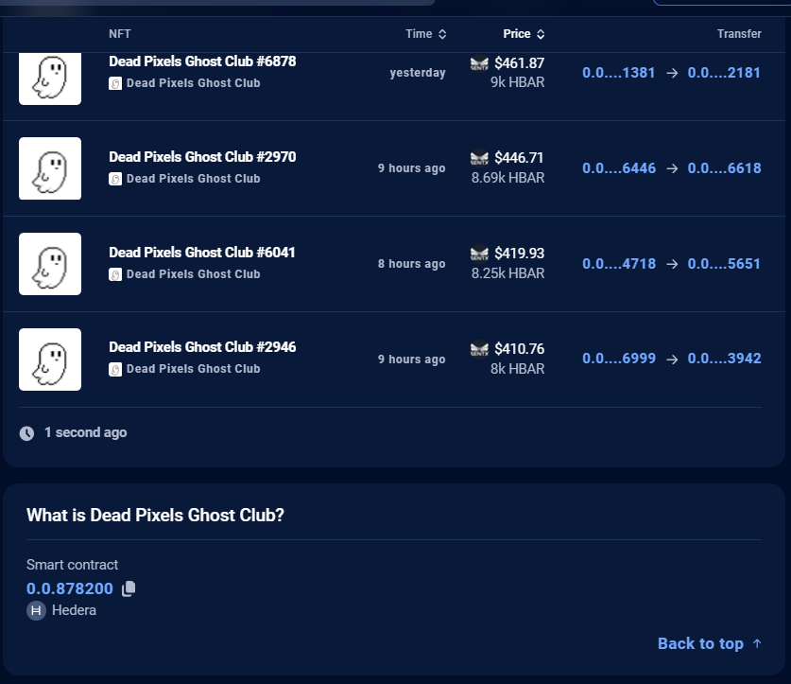
Top ten contracts order by volume
source:dappradar.com
Notes:
According the ten ranking panel ,

Slide 9
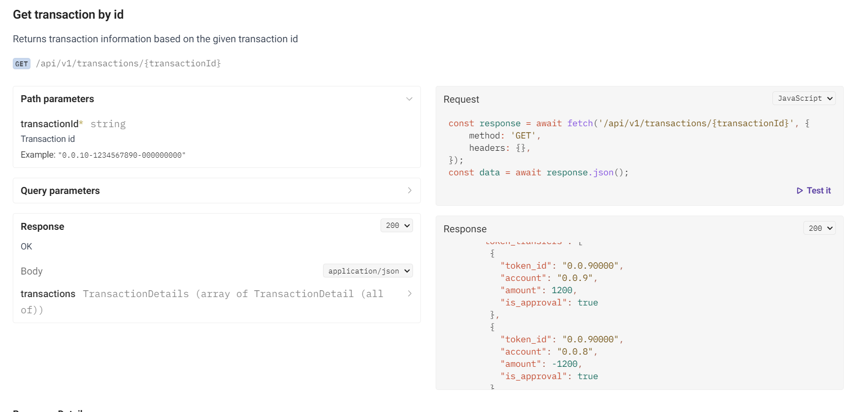
Data Acquisition Solution
/api/v1/transactions/{transactionId}
Notes:
Use the transaction hash to get sender and receiver details accounts detail in the transaction ，Get the Top 10 volumes contracts detail and to calculate the concentration index ,comparison data and so on, get 516928 result rows

Slide 10
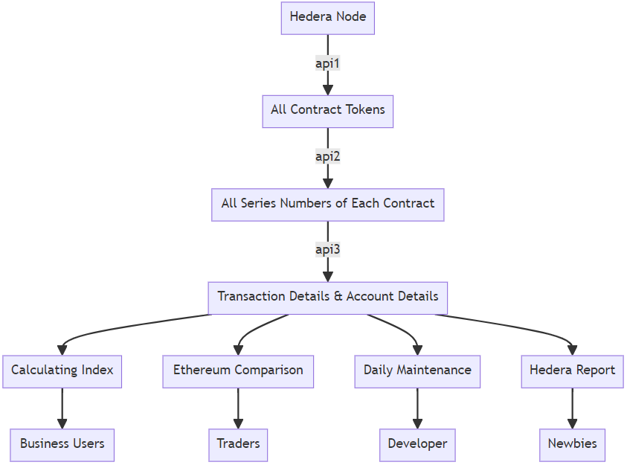
Data Acquisition Solution
The whole process of data collection Flow chart
Notes:
Flow chart

Slide 11
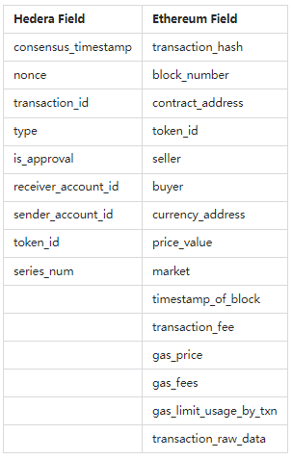
Field difference
comparison table
Notes:
In summary, Hedera and Ethereum focus on different aspects in their fields, reflecting their distinct design philosophies regarding transaction processing, fee structures, and account management.

Slide 12
Hedera Achievements
Get 29,011 contracts , and 25,000+ traded
Get 9M+ transaction records
Get top 10 NFT transaction 516,928 detail rows
Data comparison : Ethereum vs Hedera
Notes:
Achievements，https://github.com/xujiahuayz/hedera-staking.git

Slide 13
Importance of block chain
Why？
1. Decentralization and Trust
2. Transparency and Traceability
3. Cryptographic Security and Privacy Features
4. Efficiency and Cost Reduction
5. Innovation and New Business Models
Notes:
数据对投资和监管都很重要，数据

Slide 14
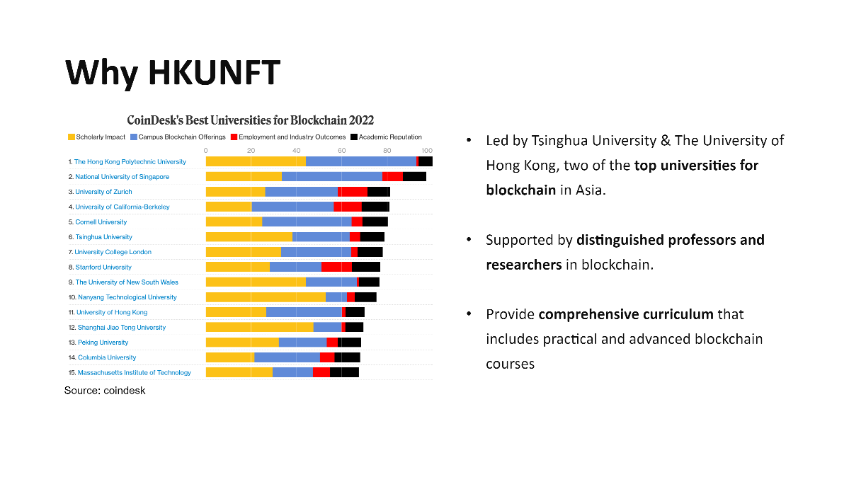
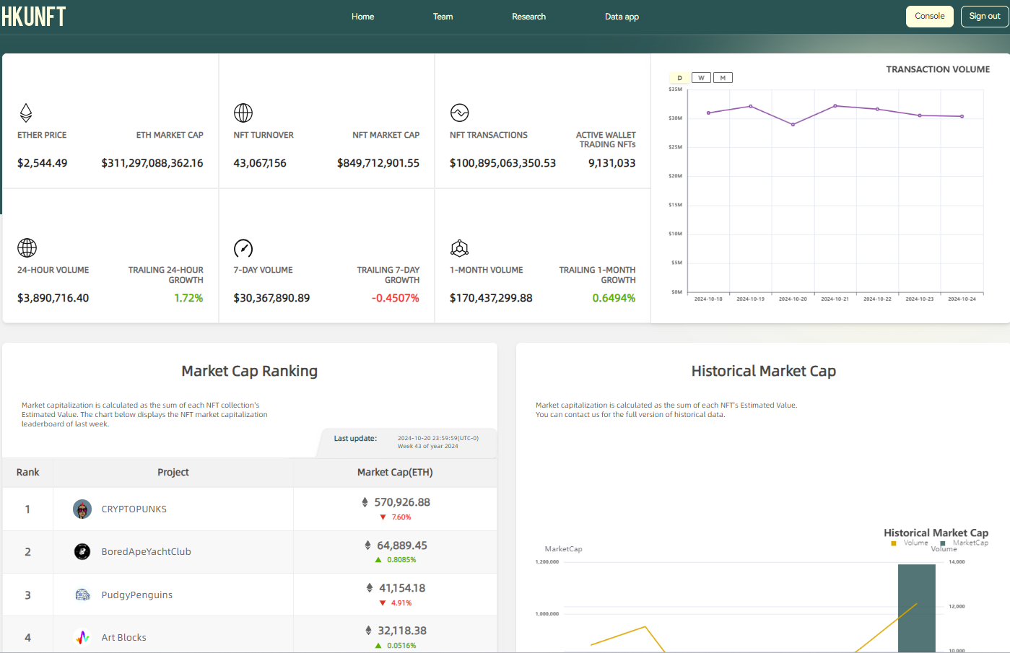
HKU NFT HOME PAGE
Notes:
Home page https://hku-nft.com/
Here are the features of the data analysis services provided by HKUNFT:
Real-Time Data Access: Users can seamlessly integrate real-time NFT data through a robust API service, facilitating application development.
No-Code Analytics Dashboard: Offers a no-code analytics tool that allows users to easily gain valuable insights into the NFT market.
Transaction Data Analysis: Analyzes sales volumes, prices, and buyer/seller behavior to help users identify market trends and dynamics.
Statistical Metrics Support: The API not only provides raw data but also supports statistical metrics, allowing users to retrieve needed information with simple code.
Research and Reports: Provides NFT-related research reports authored by researchers from top universities, helping users gain a deeper understanding of the market.
Extensive Data Coverage: Covers multiple markets with a vast number of NFT transfer records and collection data, ensuring comprehensiveness and accuracy.

Slide 15
HKU-NFT
All-in-one NFT Data Analysis Platform
Comprehensive Data Insights
Customized Data Dashboard
Outstanding Academic Contributions
Top Academic & Development Team

Slide 16

All-in-one NFT Data Analysis Platform
On-Chain Data
HKU NFT Data Analysis Platform
Developers
HKU-NFT
API
OpenSea
Raw Data
Filtered Data
Key Metrics
Blur
HKU-NFT
Dashboard
Analysts
X2Y2
Web3
Node
Logs
Topic
Token_id
Transfer
Address
Volume
Market Cap
Strike Price
Transactions
Active Wallets
Minting
...
LooksRare
Cleaned
Augmented
HKU-NFT
Weekly Report
Traders
Zora
HKU-NFT
Lecture
Newbies

Slide 17
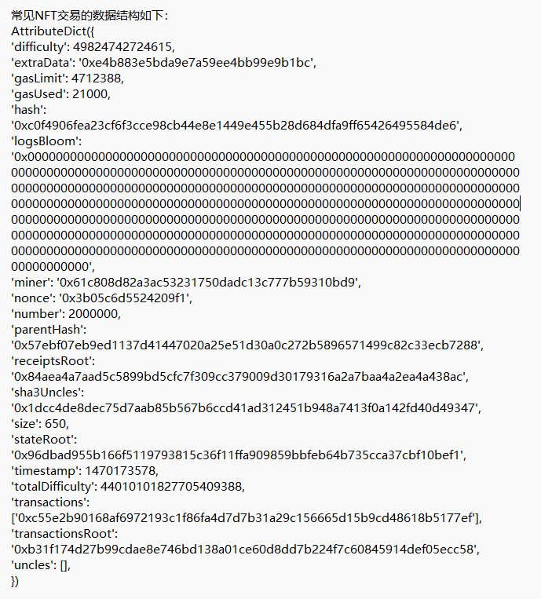
Comprehensive Data Insights
Key Metrics Extraction:
Analyzing critical data directly from the blockchain.
miner
parentHash
gasLimit
gasUsed
difficulty
extraData
hash
gasLimit
nonce
stateRoot
logsBloom
hash
extraData
sha3Uncles
timestamp
Notes:
It can be understood that every transaction has the basic information and details of the transaction, the basic information is as shown in the figure above, andThe details refer to the transaction log here

Slide 18
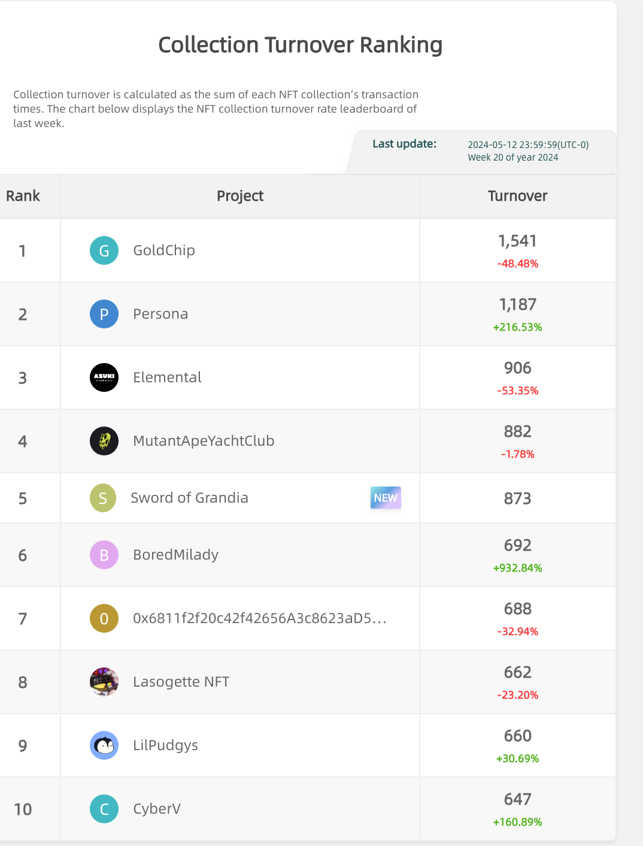
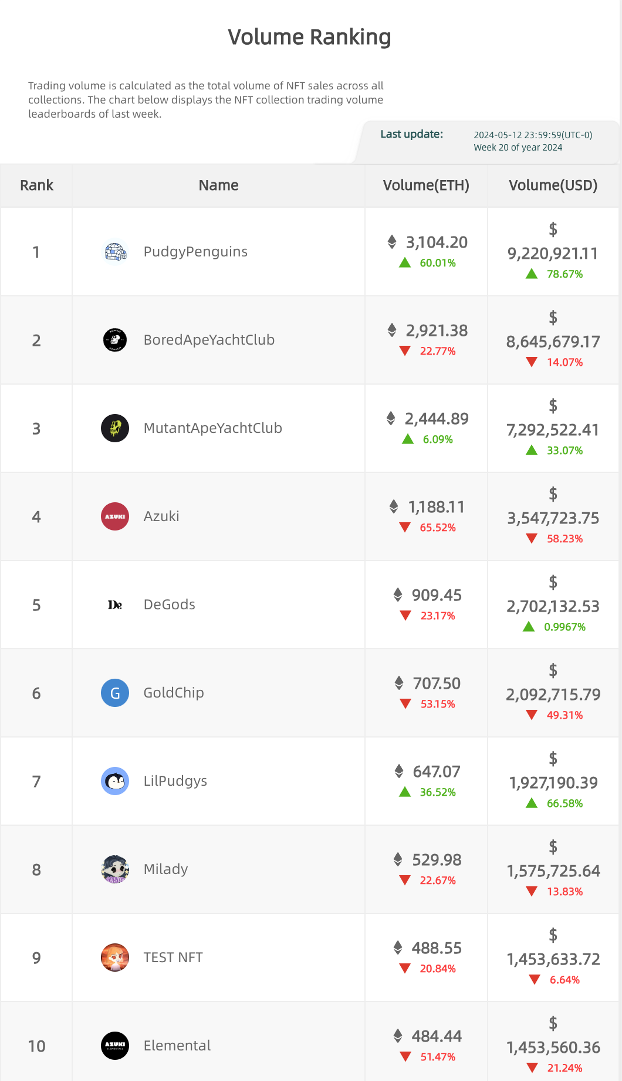
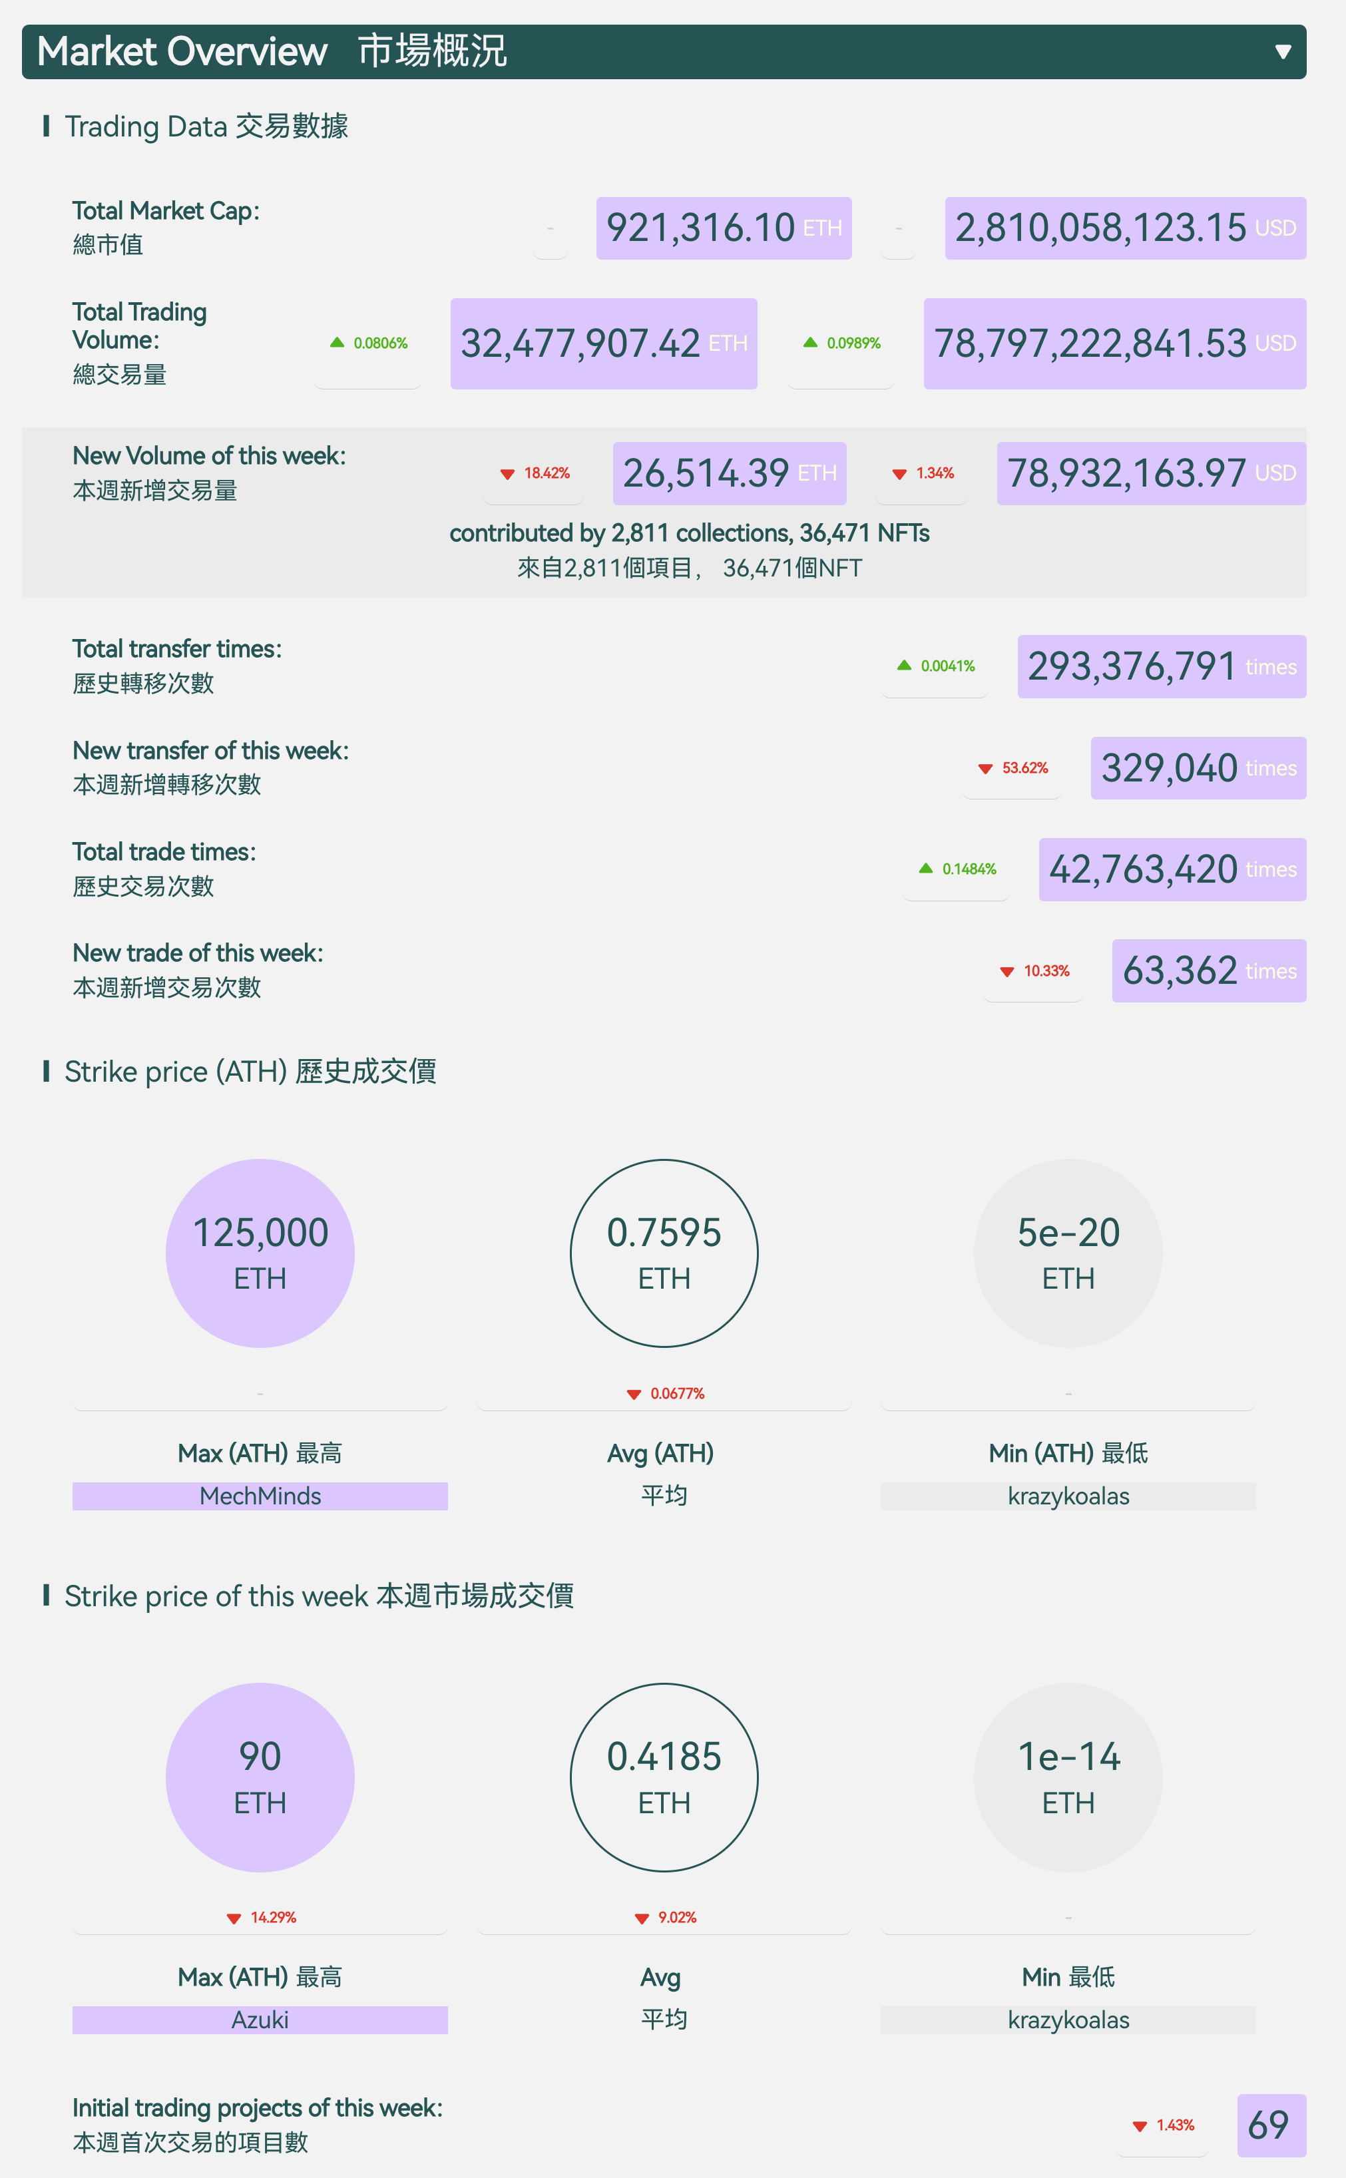
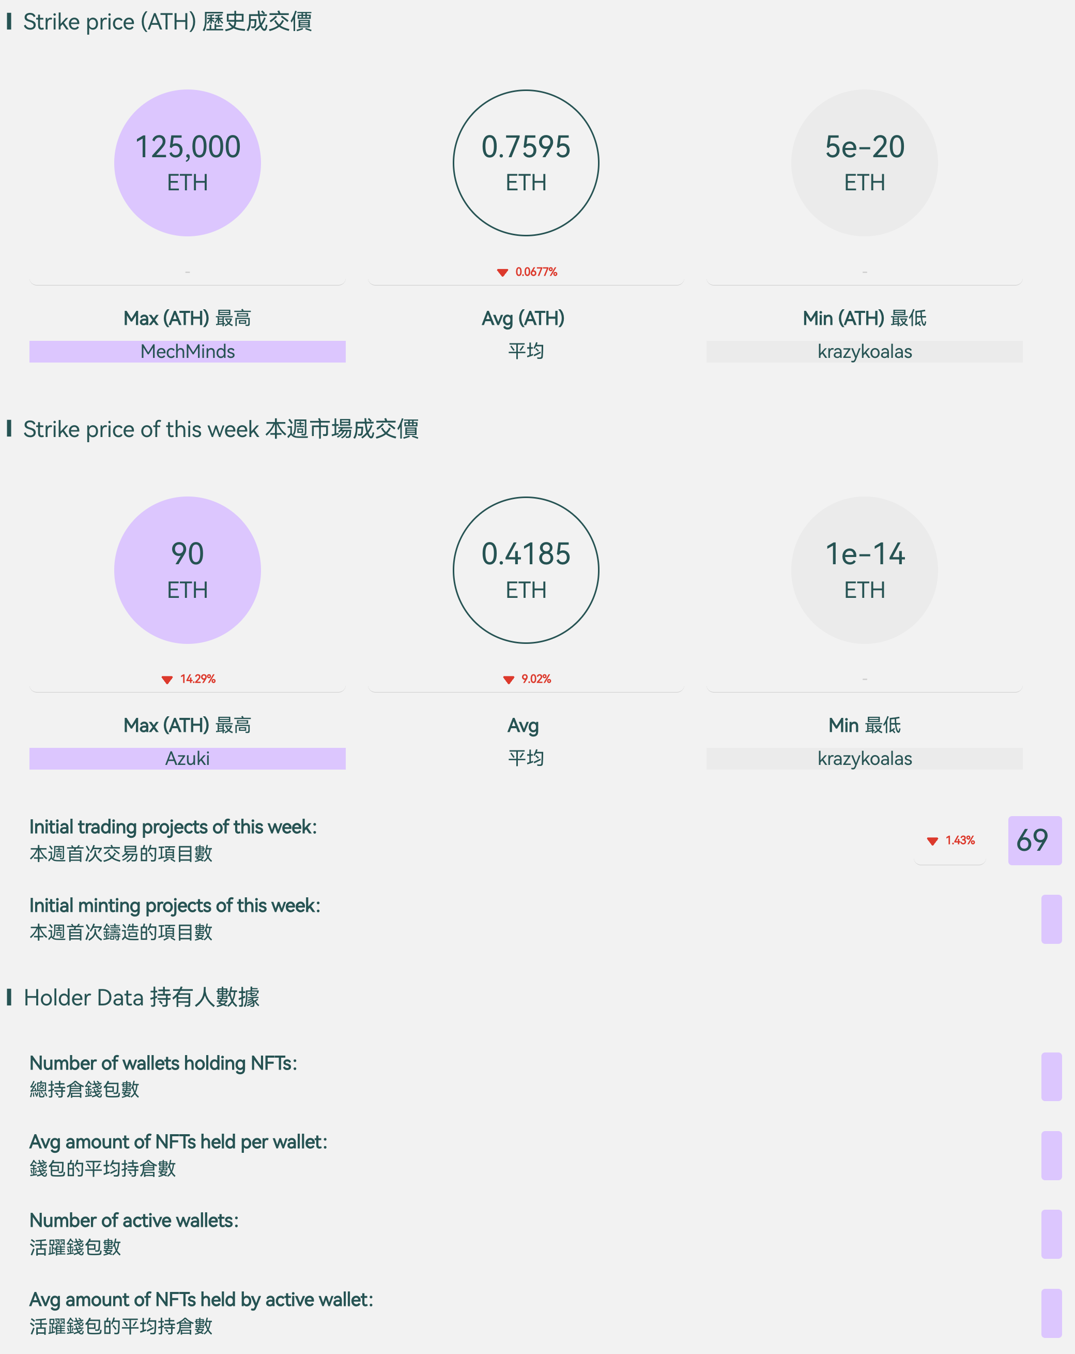
Comprehensive Data Insights
Financial Indicator Analysis:
Market Overview
Trading Volume
On-chain Transactions
Turnover

Slide 19
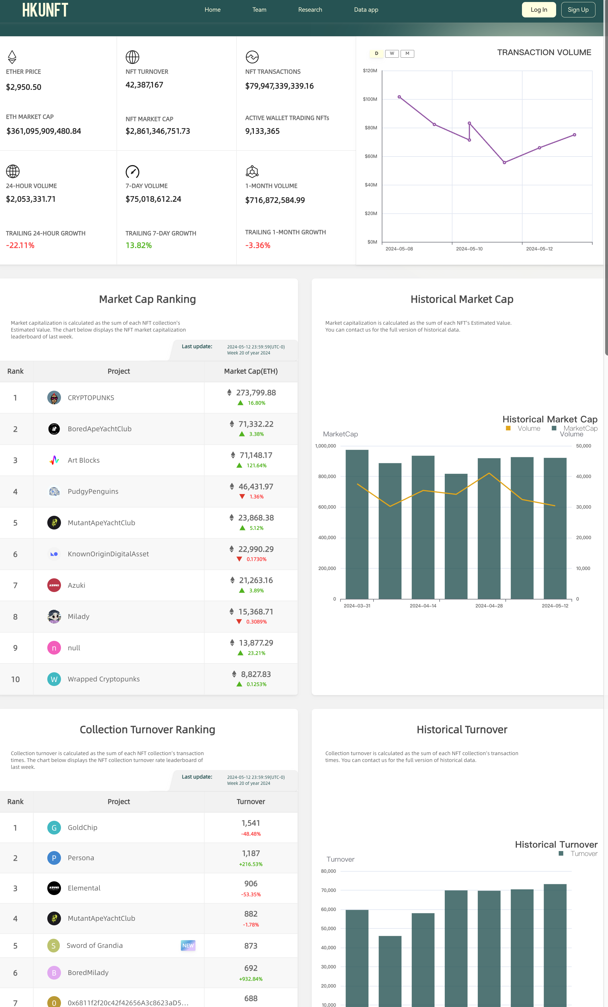
Customized Data Interface
NFT Data Dashboard
All-in-One View
Rankings & Trends
In-Depth Analytics

Slide 20
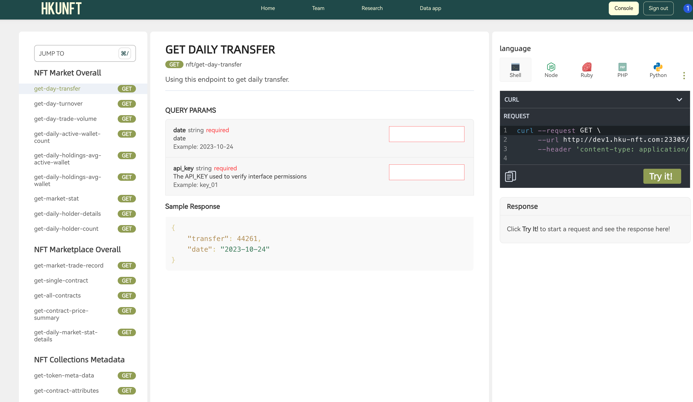
Customized Data Interface
APIs for Pro
Personalized API Keys
Seamless Integration

Slide 21
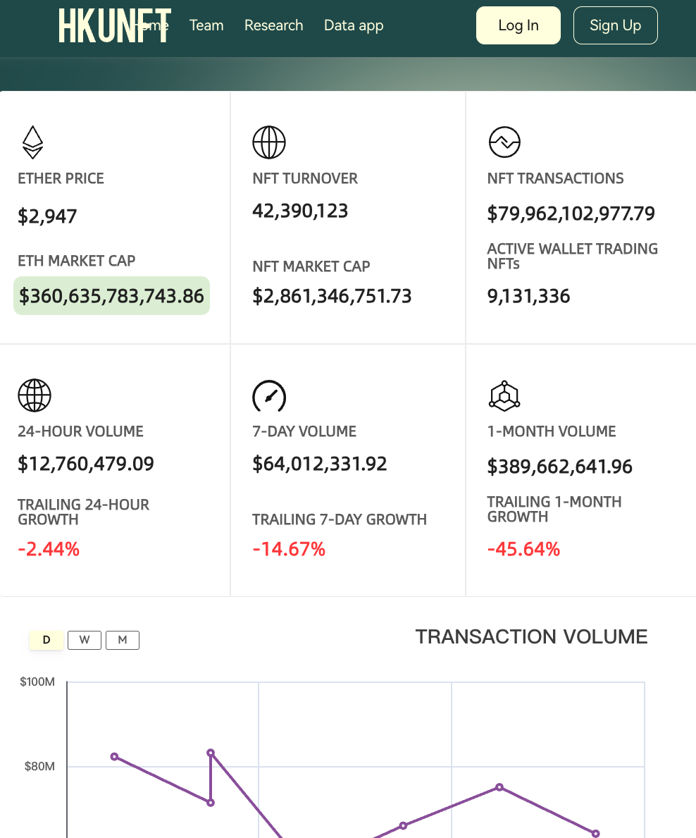
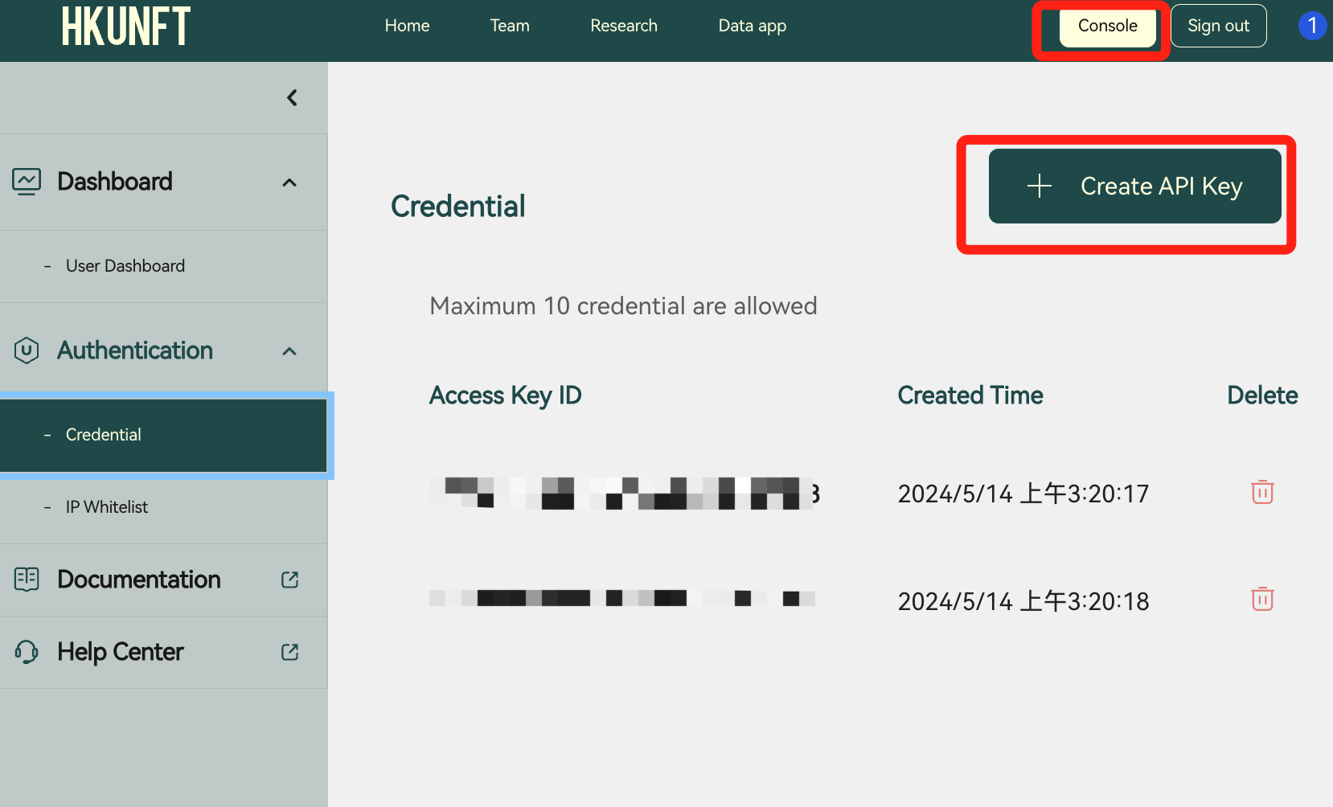
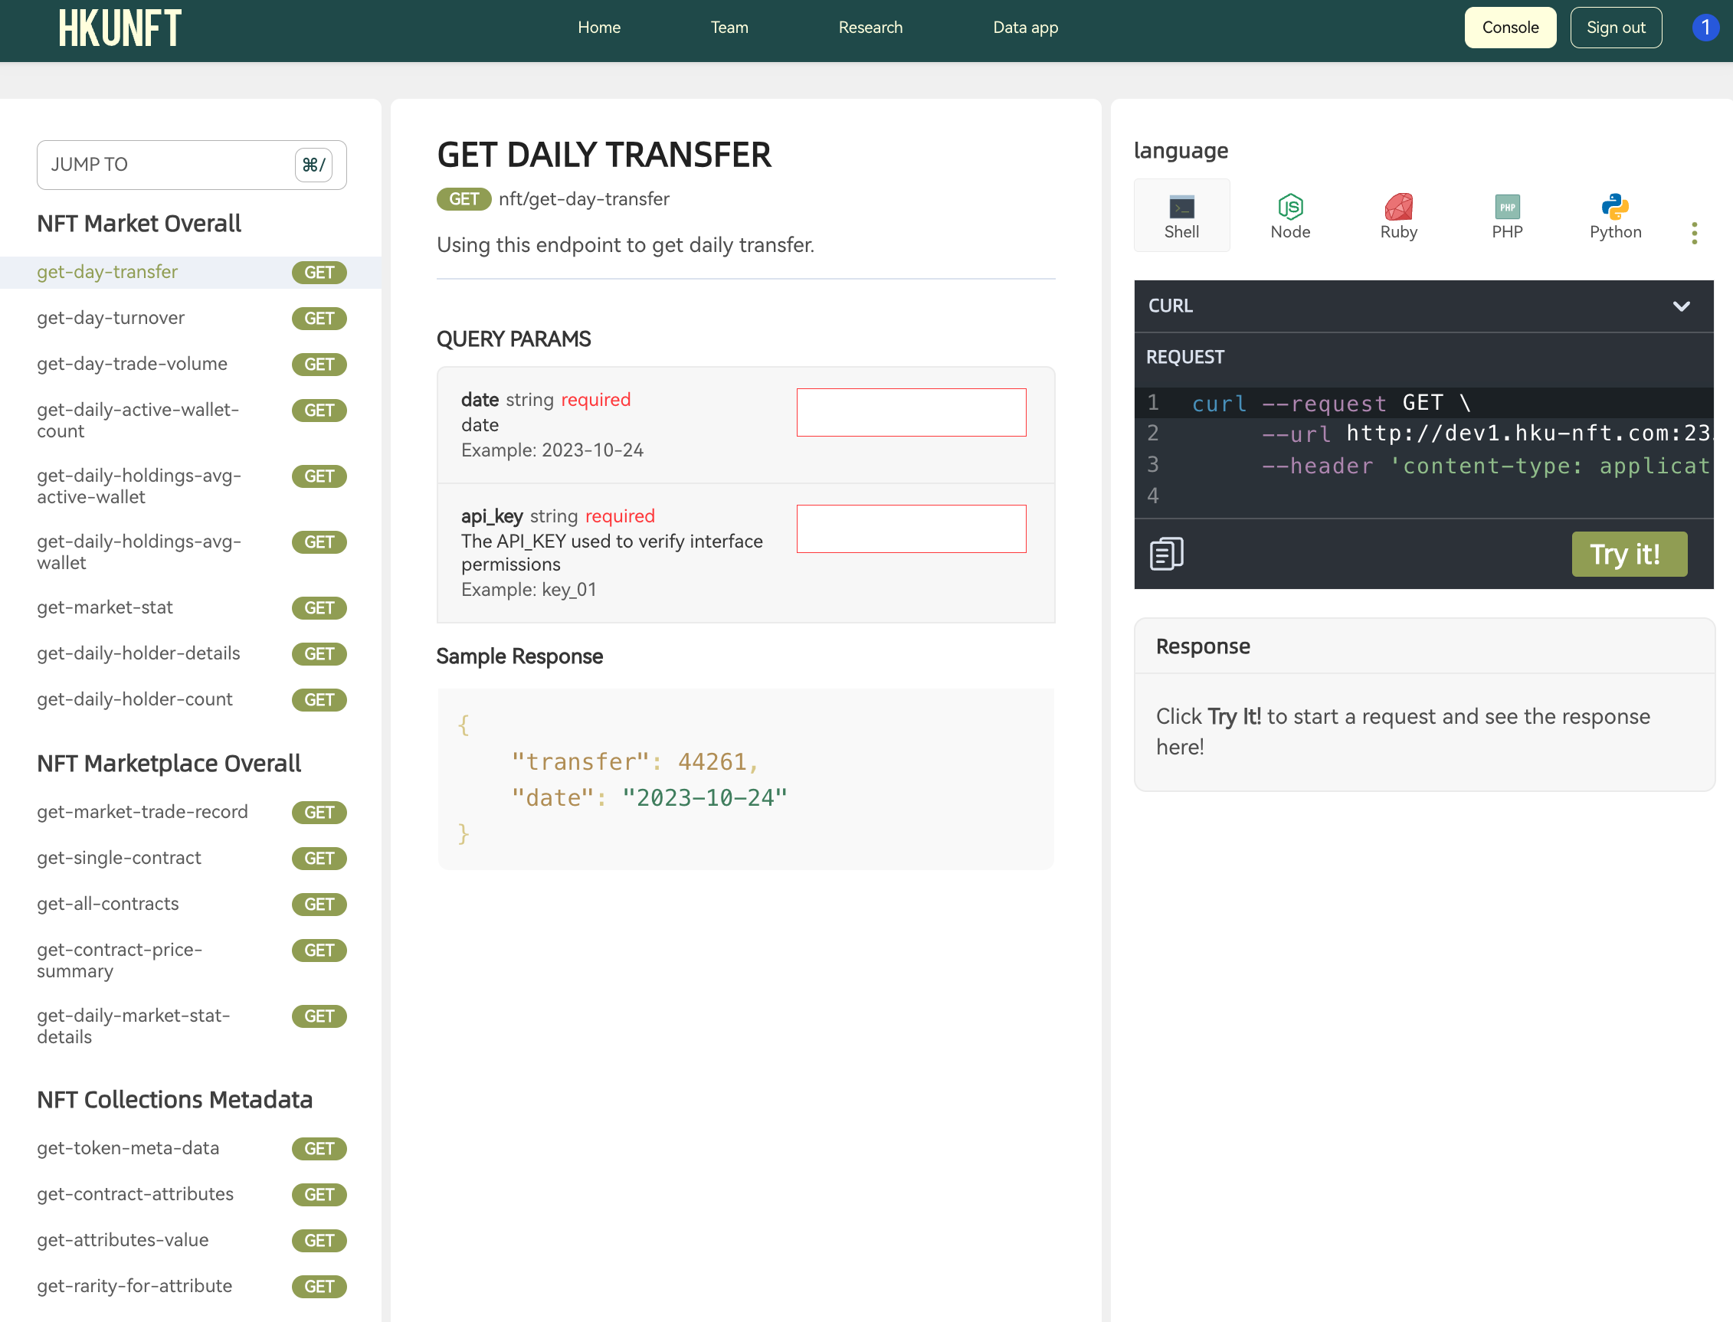
Customized Data Interface
APIs for Pro - A Step by Step Guide
1. Sign in
2. Enter the console and create your API key(keep it safe!)
3. Get cleaned NFT data

Slide 22
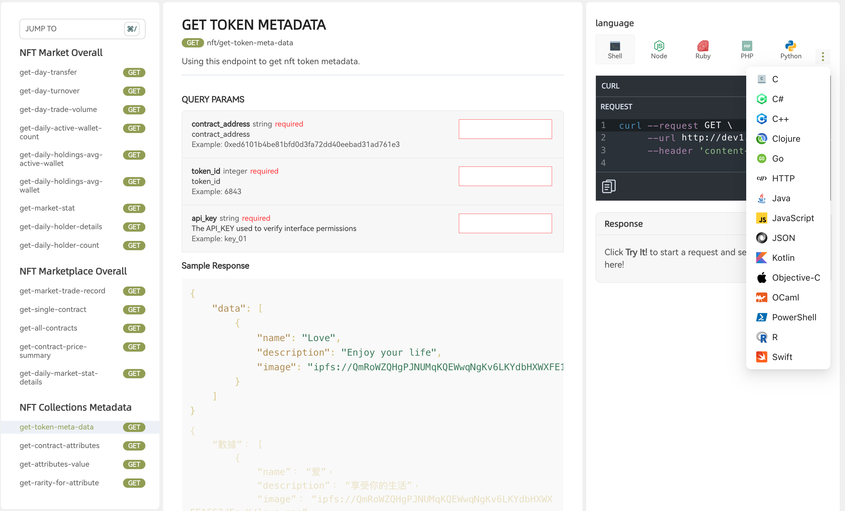
Customized Data Interface
APIs for Pro
20 Languages
18 Mtetrics
Filtered, Cleand, Augmented.

Slide 23
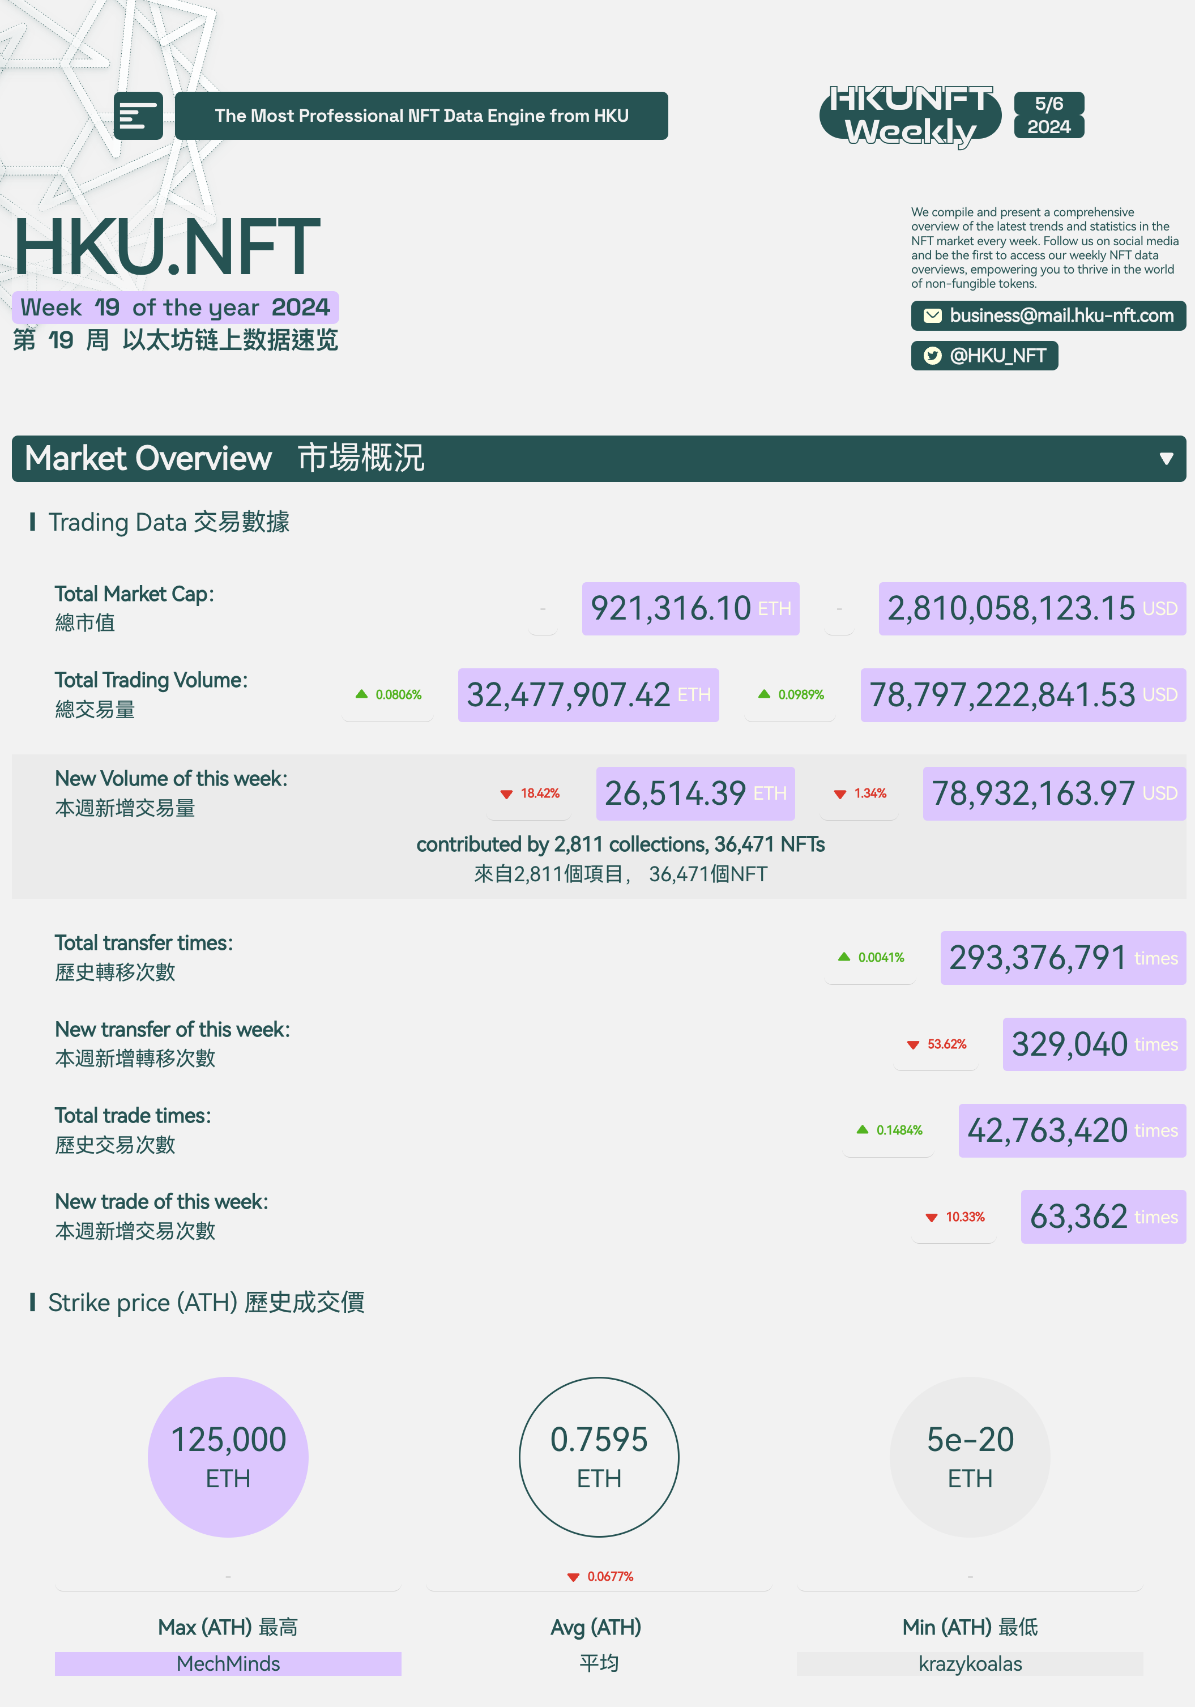
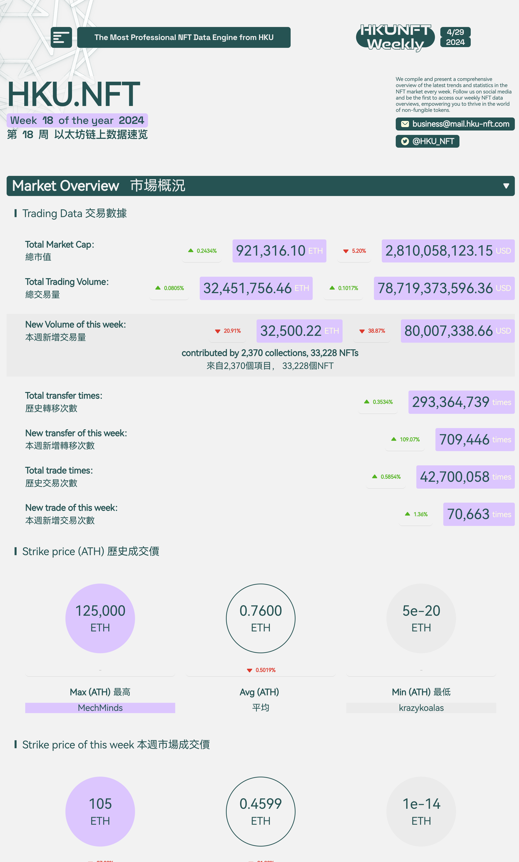
Customized Data Interface
In-depth Weekly NFT Report
Comprehensive Market Overview
Actionable Insights
Stay Ahead
Ideal for Decision-Makers

Slide 24
Outstanding Academic Contributions
Research Team & Publications
Our dataset, offering comprehensive and highly reliable NFT transaction data, is an invaluable resource for researchers. With clean and accurate data covering the majority of NFT transactions, it significantly streamlines academic research.

Slide 25
Outstanding Academic Contributions
Educational Curriculum Collaboration
For CS/Fintech:
Comprehensive blockchain technology theory
Smart contract development and DApp creation
Advanced blockchain/NFT data analysis
Computer vision for NFT image analysis and rarity assessment
For Finance/Business:
Fundamental blockchain theory
Practical blockchain applications
Blockchain/NFT data analysis from a financial perspective

Slide 26
Vision & Mission
Building Long-term Partnerships with Universities
Providing Comprehensive API Services for Institutions
Contributing Cutting-Edge Databases to Academia
Exchanging Knowledge and Resources with Schools
Cultivating Blockchain Talent
Notes:
1.

Slide 27
NFT Data Extract Analysis
Content
Block chain industry
Market vacancy
Bright prospect
course introduction and design

Slide 28
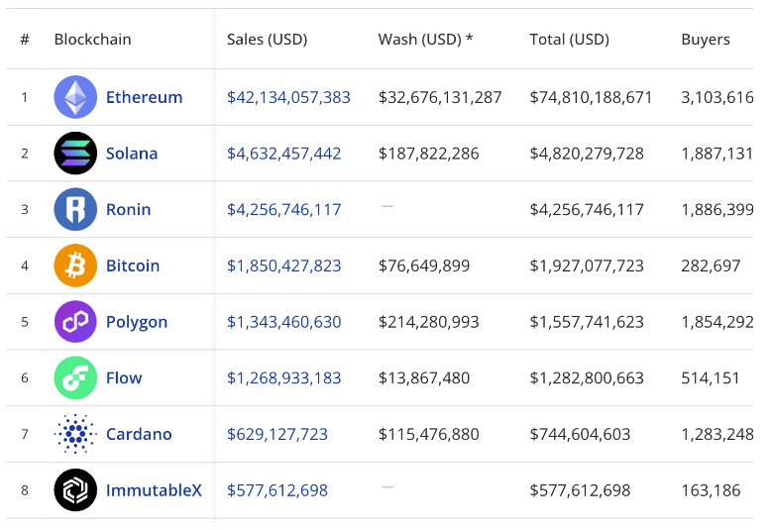
All TIME Blockchains by NFT Sales Volume
Bright prospect
Source:Cryptoslam

Slide 29
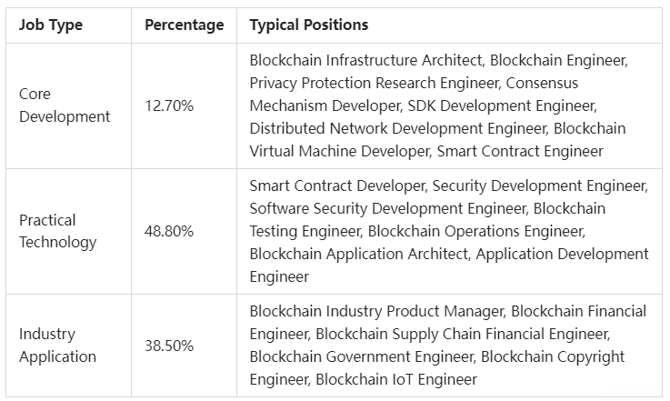
Market vacancy

Slide 30
Course introduction and design
1.Base knowledge of block chain
2.NFT Cultural and commercial value
3.NFT data analysis methods
4.NFT data storage and parsing
5.NFT financial indicators

